Slide 1


Intelligent Parking Assistant
Presenter: Henry Huang
Team: IntelliPA
Hackathon FY20

Slide 2

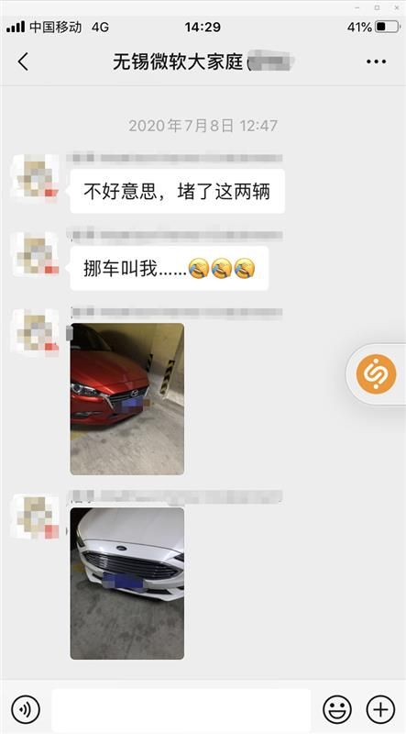
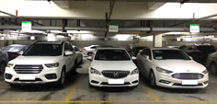
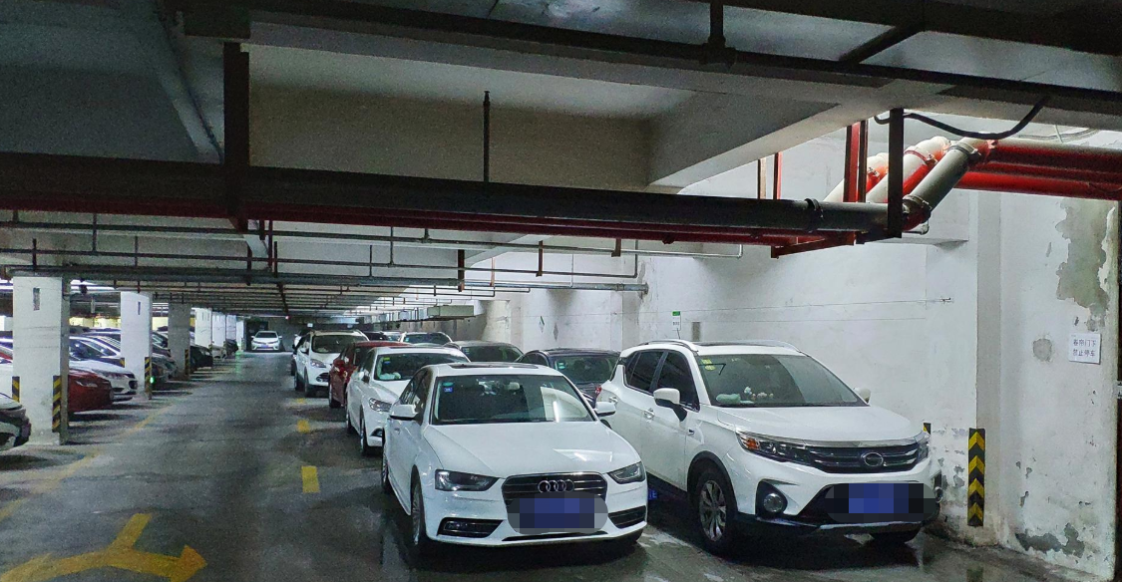
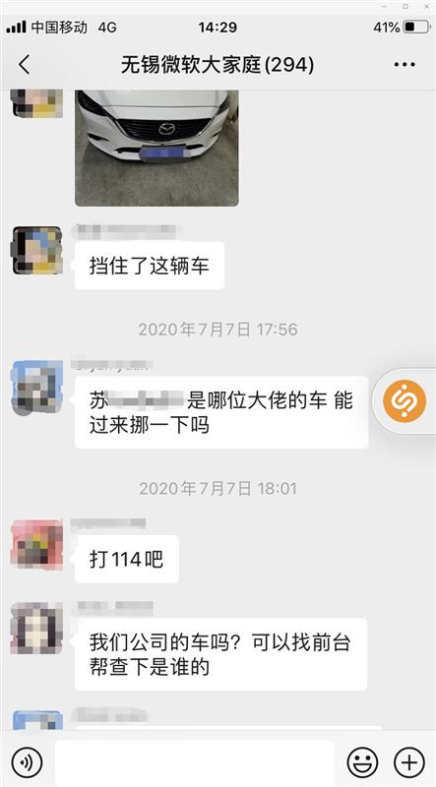
Issue & Potential Resolution
Limited Parking Spaces VS. Increasing Cars
Parking Bay cannot be easily re-constructed. Hence, we have Flexible Parking Bay
Also we need Intelligent Parking Assistant for more capacities and abilities.

Slide 3
Resolutions
Flexible Parking Spaces
IntelliPA, Parking Bay Managing Platform
Shared Car Park and more

Slide 4

Resolution - Flexible Parking Bays
Flexible Lots
Normal Lots
Indicating Line
Wall/Blocks
Head of Vehicle
Leaving Direction
Notes:
早晚离开

Slide 5








IntelliPA’s birth
Mapping
Mapping
Security and Privacy Protection
And more…

Slide 6

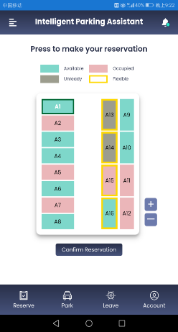
IntelliPA – Web/Mobile App
Disturbance detection & Notification
Reservation (JIT or Pre-)
Navigation
Admin tools
Automatic Check-in
Integrated with popular 3rd party tools

Slide 7
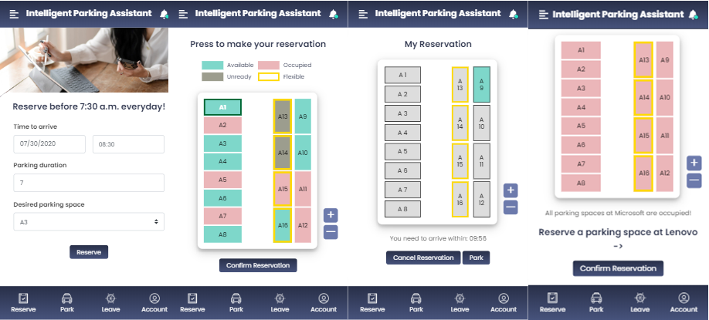
IntelliPA – Web/Mobile App
The Intelligent Parking Assistant app. (Front End)

Slide 8
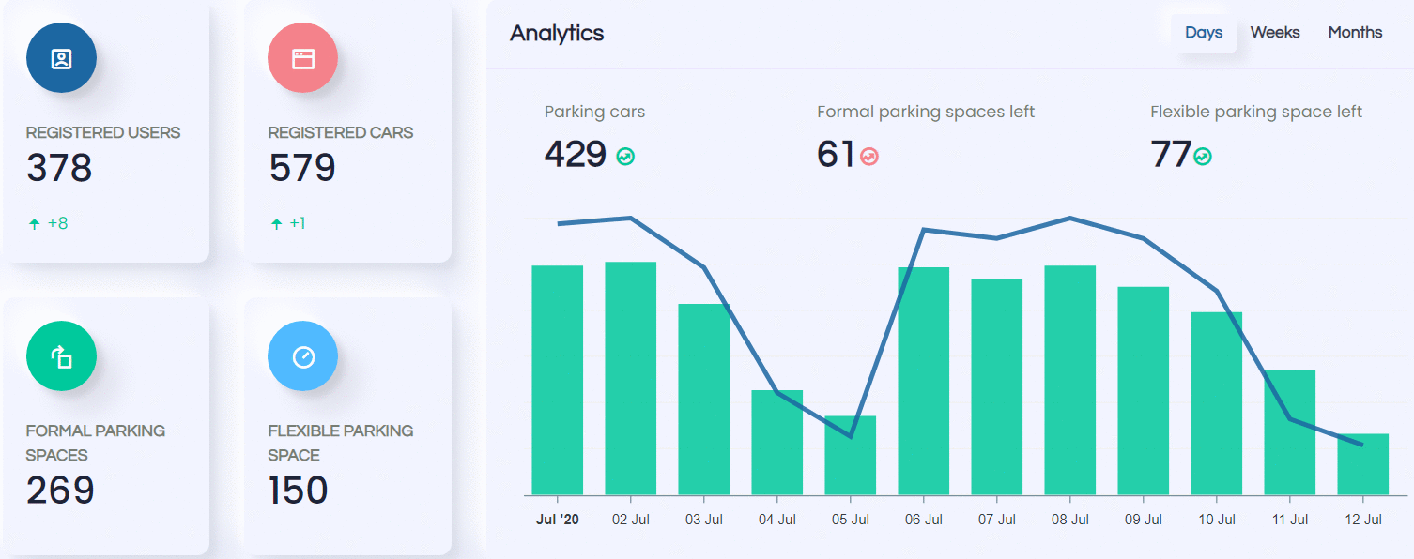
IntelliPA – Backend
Monitor
A monitor showing basic information of the selected estate.
Notes:
We developed a Back-End system for admin to see the real-time updated parking information, including remaining spaces, formal parking spaces left, flexible parking space left, remaining fixed parking spaces.

Slide 9

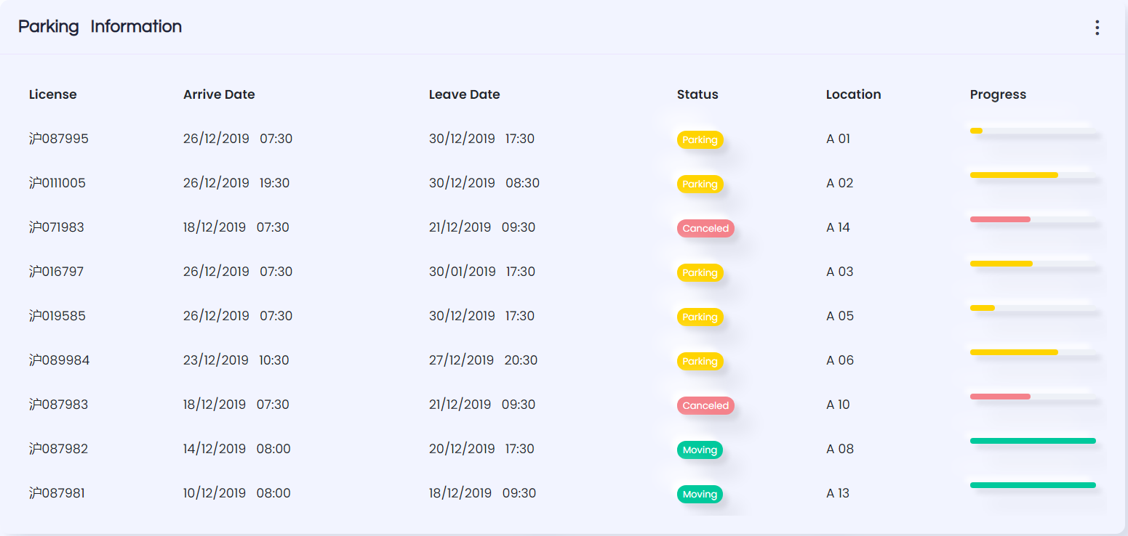
IntelliPA – Backend
Parking Logs
We also have a parking log section to show the status of each parking bay.
Current bay owner

Slide 10
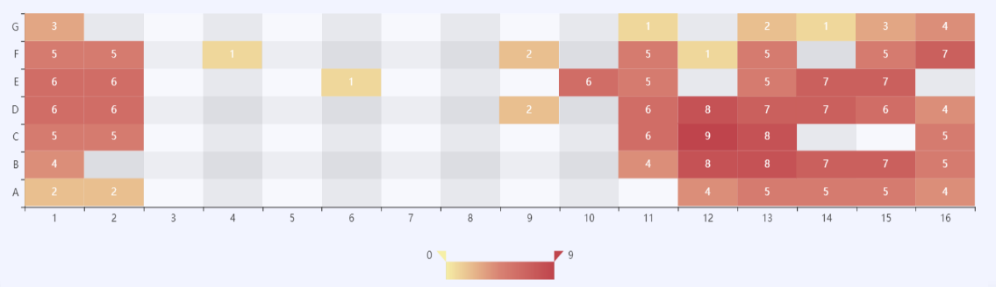
IntelliPA – Backend
Heat Map
Showing the occupied concentration of the Car Park.
Notes:
It can help the system monitor the parking flow in the area in real time, provide powerful help and support for precise command and dispatch, reasonable allocation of parking spaces, and scientific and efficient formulation of diversion strategies.

Slide 11














Intelligent Parking Assistant
Front End
APP
Interact with users
Azure
Xamarin
QRCode.js
Azure App
Service
Transform web app to client
QR Code Recognition
Static Web Apps
Azure Function
App
Empower performance
Distribute app to everyone
MyBatis
Back End
Database mapping
Azure
Spring
Powerful framework
Azure SQL
Azure Cache
Redis
NoSQL

Slide 12
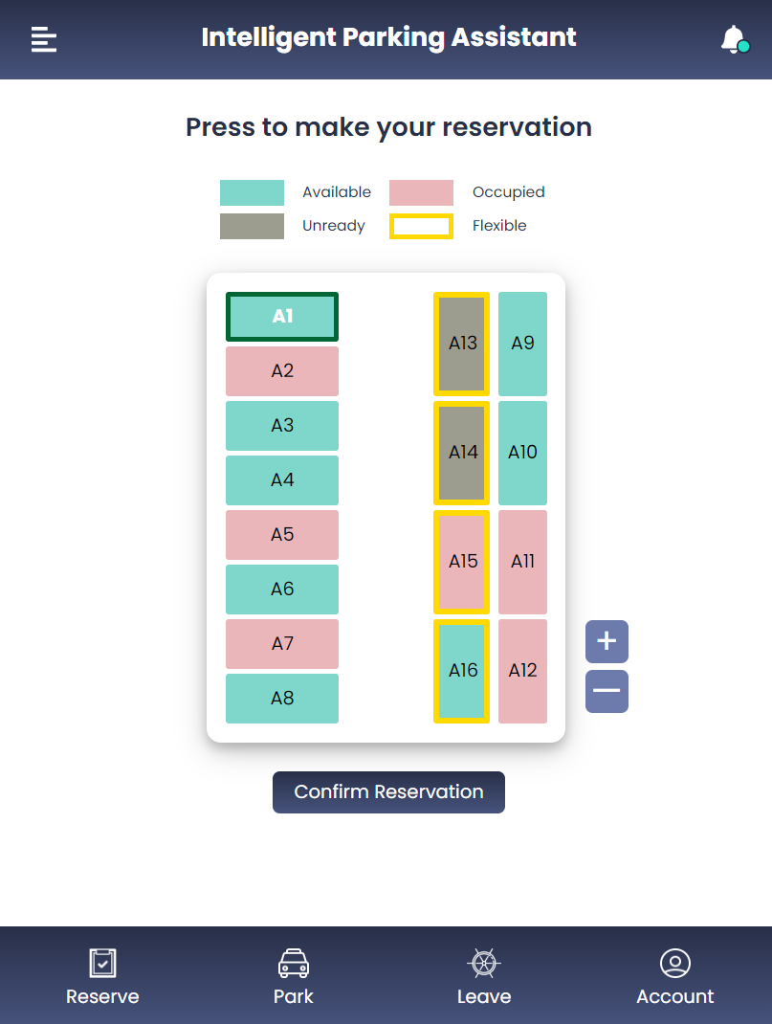
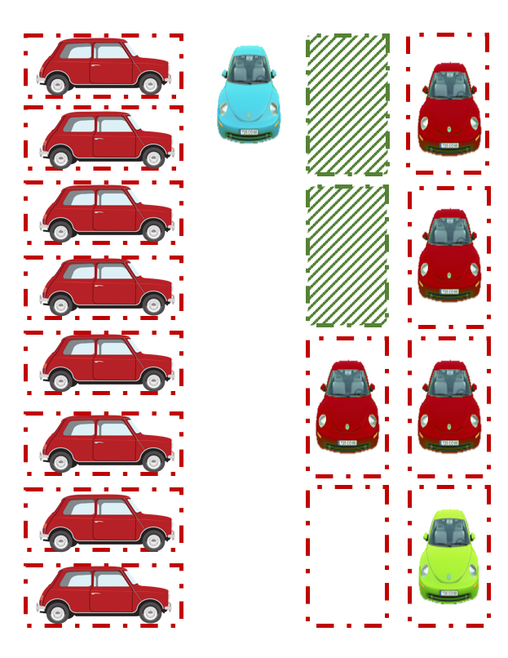
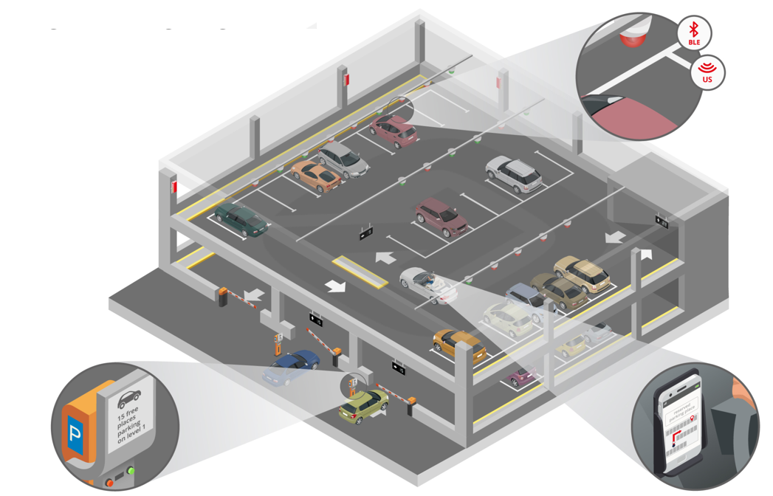
Core Advantages
Reservation & Parking Bay Navigation
Help users to find their pre-selected parking bays quickly
Flexible Parking Bay & Intelligent Management
Increase parking lot capacity without physical expansion by Flexible Parking Bay Algorithm
Shared Parking Spaces & Integrated Management with IoT
Fully utilize your/your company’s idle parking space resources and get rewarded!
Integrated Management system can help you manage every resource

Slide 13
Let’s dive into the reality!

Slide 14


Slide 15
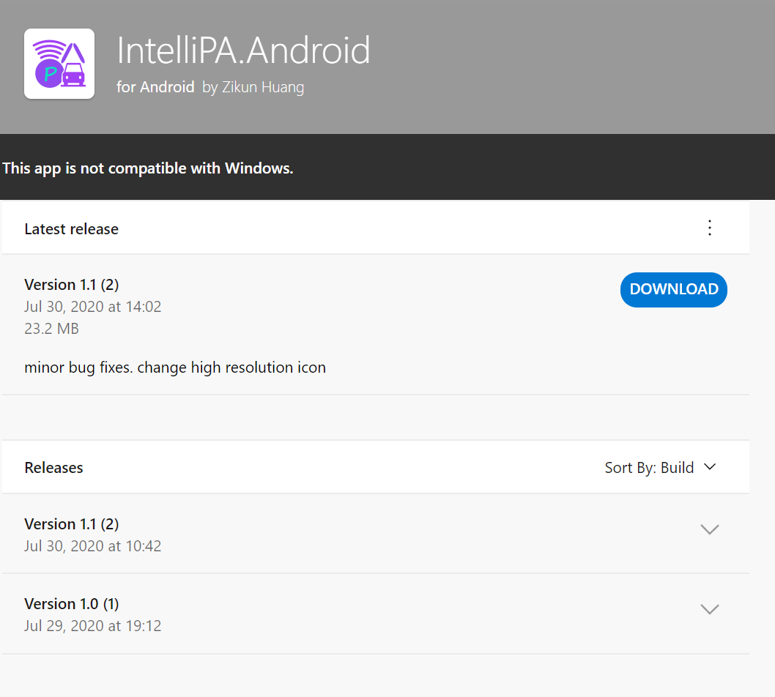


Scan the Bar Code and join our Android Beta Squad!
Also, iOS beta version is landing soon!

Slide 16









Meet our great TEAM!
Fan Xia
Aspire Program
Suyu Huang
Aspire Program
Zhengze Li
Aspire Program
Ziyao Hong
Aspire Program
Yonghui Feng
Aspire Program
Henry Huang
Support Engineer
Shuhao Yu
Support Engineer
Danwei Ruan
Support Engineer
Joe Wu
People Manager

Slide 17
Thank you!

Slide 18
Shared Car Park
Group A
Group B
Idle Parking Bays owned by different companies or individuals, can be temporally shared to others.
Admin of each company or org can manage their parking bay resources via IntelliPA.
This can be extended to residential communities and business park districts etc.

Slide 19
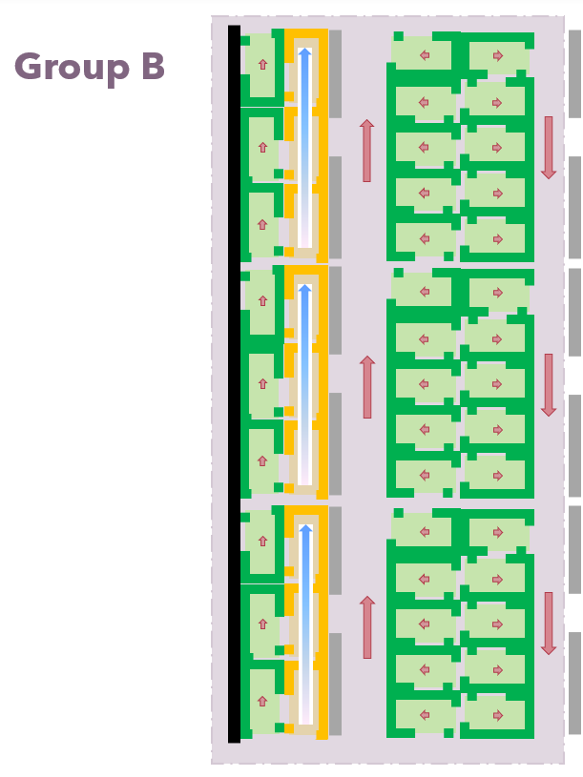
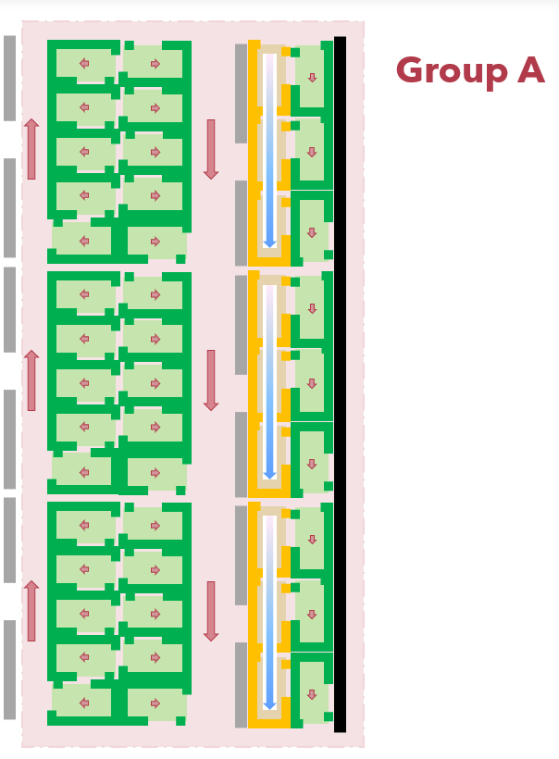
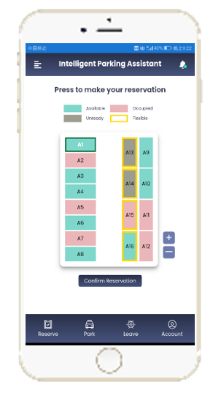

Shared Car Park
Hi there, do you have 10 bays available today?
Idle parking bays available
Parking bay full!
Group A
Admin
Group B
Admin
Yes, we got more than 10 idle bays today. Feel free to take it :D

Slide 20
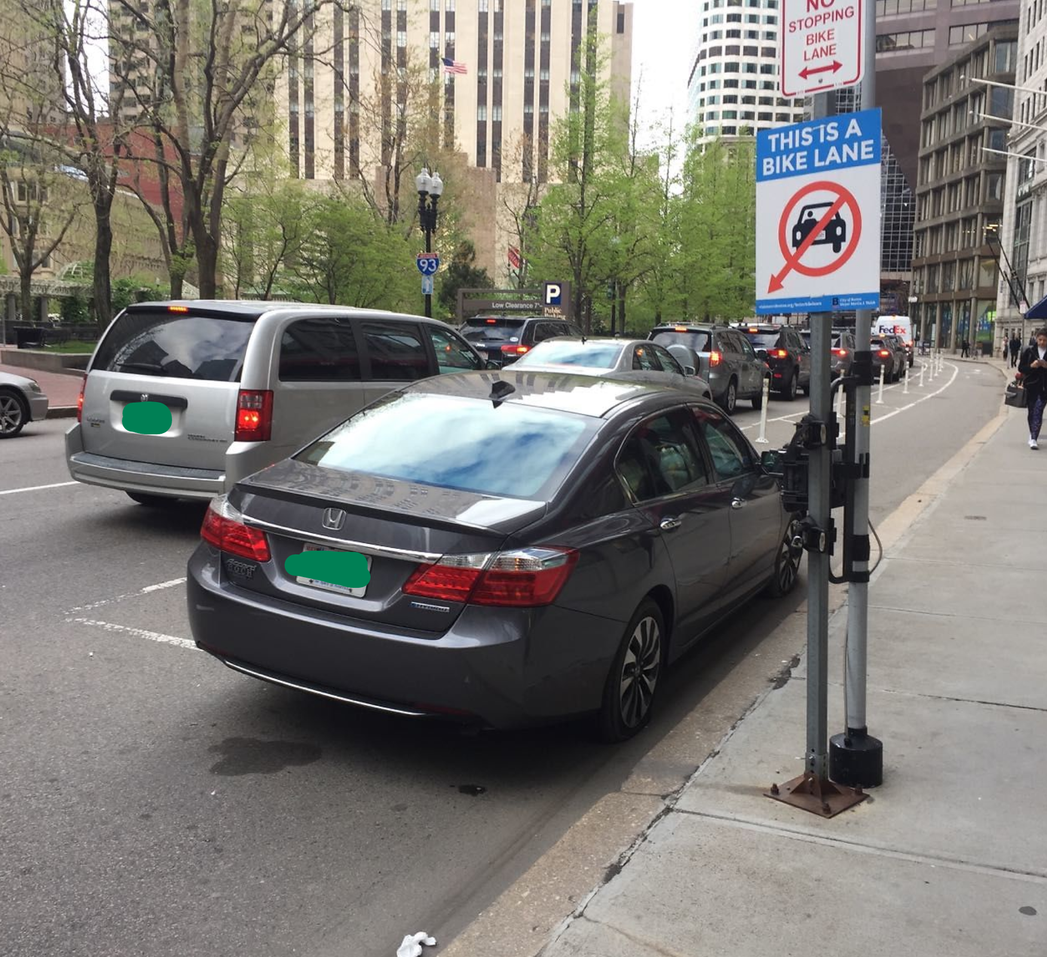
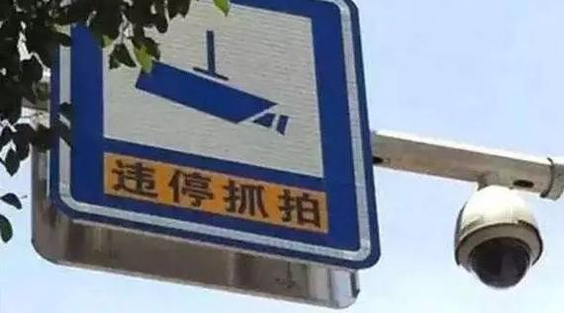
More on Flexible Parking Bays
Parking behavior will attempt to become entropy-increase, if convenience weighs.
Restriction and manual management will waste loads of labor/material/time resources.

